Slide 1
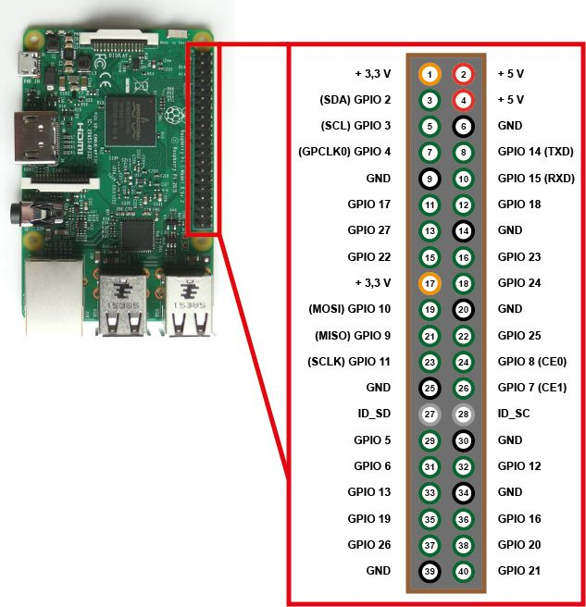
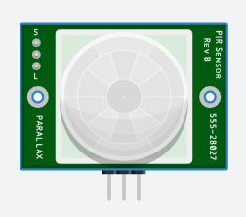
VCC
5V
GND
OUT
GND to RPi GPIO Pin 6
OUT to RPi GPIO Pin 11
VCC to RPi GPIO Pin 2

